Slide 1
Weekly Update
Jorian Bruslind
Week 7

Slide 2
HyperRail Project
Current Status
Integrated new RGB camera into system
Some challenges with lighting and streaming
Easy to use with correct software installed
Updated Web interface to give access to images
Can download latest runs as .zip files
Having trouble with preview function (no idea how ruby works)
Scheduling conflicts with defense meeting

Slide 3
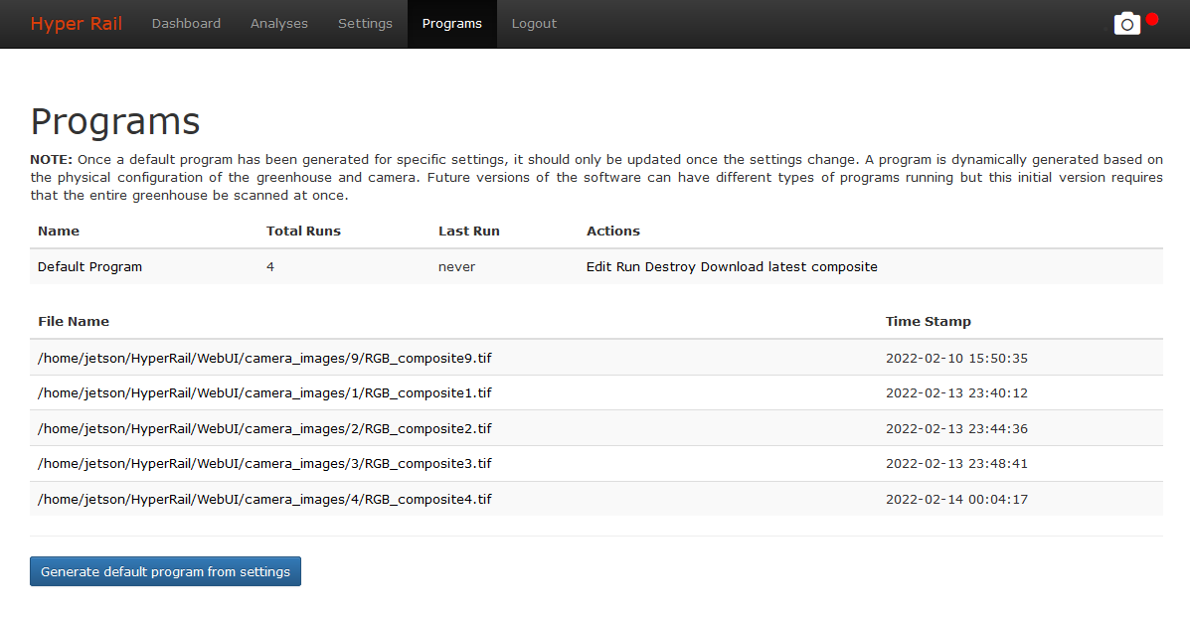
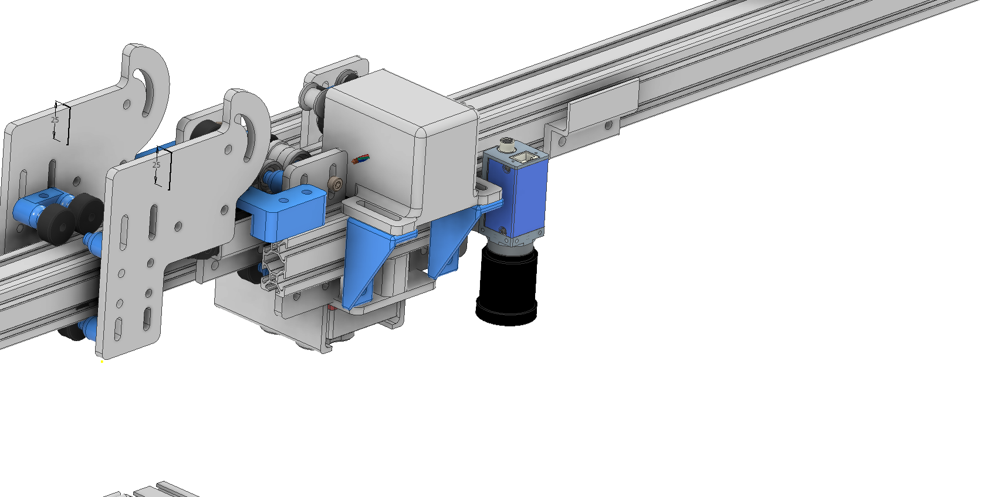
Current Status

Slide 4
Project Work
Working with both IE and ME capstone teams to develop hardware further
ME team is working on stability and assembly components
Better carriages (CNC aluminum vs 3D printed plastic)
Better wire guides (current guides are limited by length)
Festoons! <- One of the best ideas
Better structural stability
Employ tensioned cable as gusset supports
IE team working on documentation and assembly designs
Exploding 3D models into Lego-like designs
Writing and drafting instructions
User feedback for current system design (from user perspective)

Slide 5
Next Steps
Installation date confirmed for March 1st (Tuesday)
Need to create skeleton for defense presentation for review (preferably by this week)
Tear-down of system for ME/IE team and to retrofit for smaller footprint

